Slide 1
CETM67 Assignment 1
Loan microservice and letter generation replica
Adam Duncanson

Slide 2





Overview
Services used:
AWS API Gateway
AWS Lambda
AWS DynamoDB
AWS S3
User journeys:
Create new customer
Retrieve customer details
Create new loan
Retrieve loan details
Activate loan
Close loan
Generate letter
Download letter
Empty S3 bucket
Regenerate letter
Content Delivery
API Layer
Application Layer
Persistency Layer
AWS S3
User
AWS API Gateway
AWS Lambda
AWS DynamoDB

Slide 3

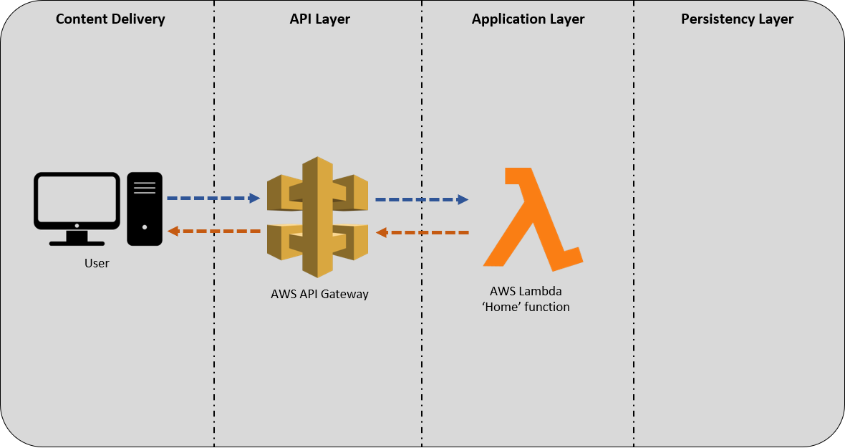
/ (Landing page)
AWS API Gateway
‘Home’ Lambda
GET
Http type?
Other
Return API details
Deny method

Slide 4
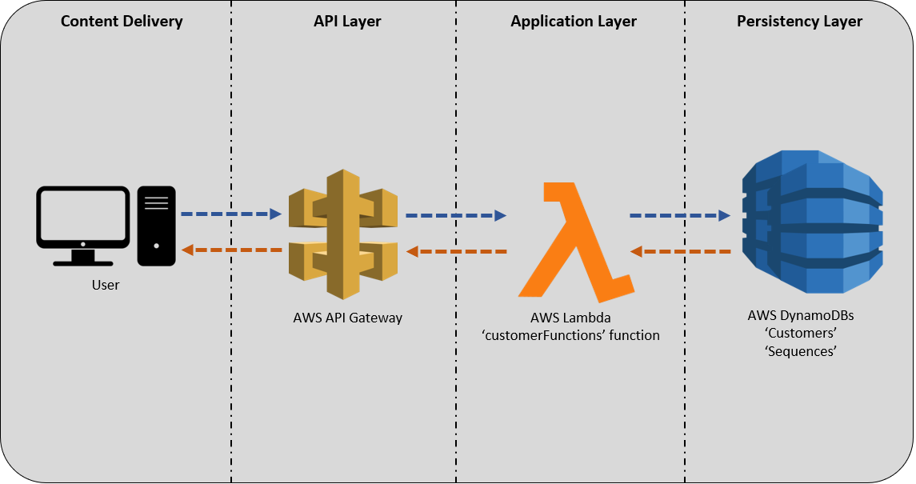
/customer
AWS API Gateway
Other
Deny method
Specify ‘customer_id’ is needed
‘customerFunctions’ Lambda
No
Validate
Query string?
GET
Http type?
Get sequence
Yes
POST
Access Customer DB
Sequences
Create customer
Errors?
Customers
Errors?
No
No
Yes
Yes
Return customer data
Return error data
Return confirmation
Return error data

Slide 5

/loan
AWS API Gateway
Other
Deny method
Specify ‘loan_id’ is needed
No
‘loanFunctions’ Lambda
Don’t create new loan
Query string?
Yes
Loan exist?
GET
Http type?
Access Loans DB
No
Yes
POST
Validate
Errors?
Access Loans DB
Get sequence
No
Loans
Return loan data
Create loan
Sequences
Return error data
Yes
Customers
Add loan to customer field
No
Errors?
Yes
Return confirmation
Return error data

Slide 6
/loan/activate
AWS API Gateway
Other
Deny method
‘activateLoan’ Lambda
Detail how to activate or cancel loan
GET
Http type?
POST
Update status to ‘Active’
Check loan status
Access Loans DB
Loans
letterGen-Function
(Welcome letter)
Yes
Is loan pending?
Yes
Check new status
Activate?
‘activateLoan’ function
No
Update status to ‘Cancelled’
No
Errors?
Return loan is not pending status change
No
Yes
Return confirmation
Return error data

Slide 7
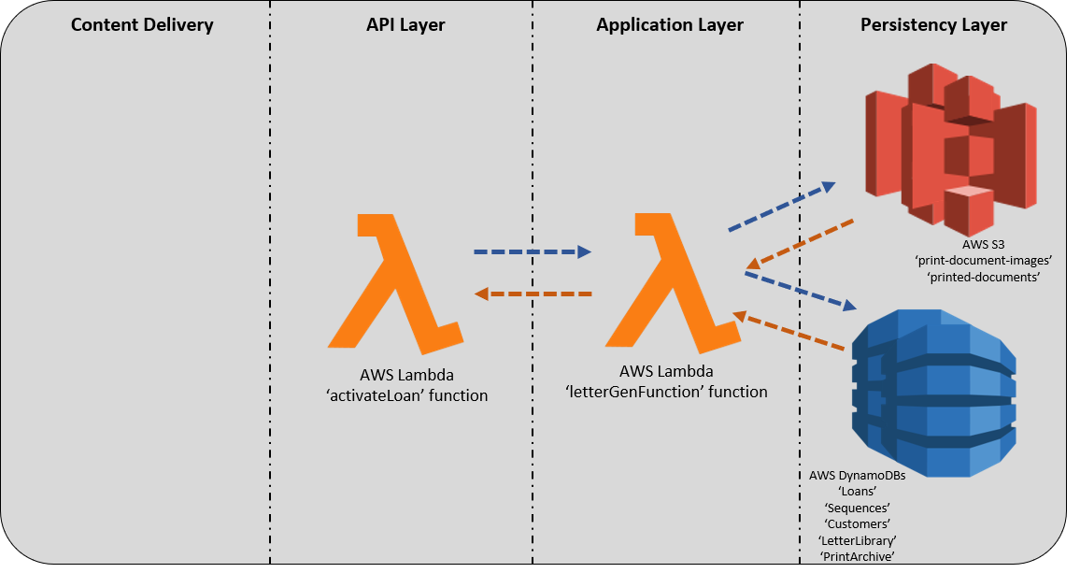
letterGenFunction (no external API)
activateLoan
closeLoan
Generate PDF
Retrieve reprint data
print-document-images
Yes
Add to ‘printed-documents’ S3 bucket
Reprint?
printed-documents
No
Reprint?
Get loan, customer, squence and letter validation data
Update loan details
Customers
Validate
Add data to ‘PrintArchive’
Loans
LetterLibrary
PrintArchive
Sequences
Errors?
No
Yes
Return confirmation
Return error data

Slide 8
/loan/close
AWS API Gateway
Other
Deny method
‘closeLoan’ Lambda
Detail how to close loan
GET
Http type?
POST
Update status to ‘Closed’
Check loan status
Access Loans DB
Loans
letterGen-Function
(Close letter)
Is loan active?
Yes
‘closeLoan’ function
No
Errors?
Return loan is not active so can’t be closed
No
Yes
Return confirmation
Return error data

Slide 9
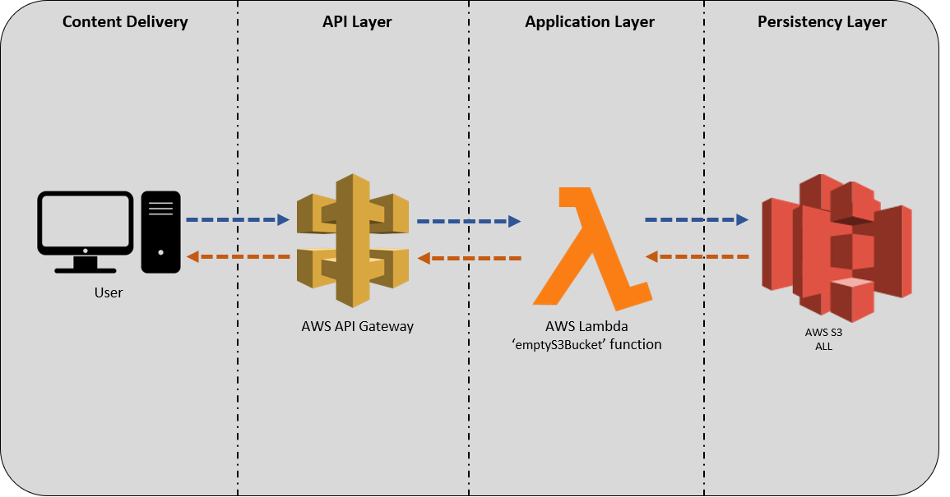
/empty-s3-bucket
AWS API Gateway
‘emptyS3Bucket’ Lambda
Detail how to close loan
GET
Http type?
Other
Deny method
POST
S3 bucket
Access S3 buckets
Empty specified S3 bucket
Errors?
No
Yes
Return confirmation
Return error data

Slide 10
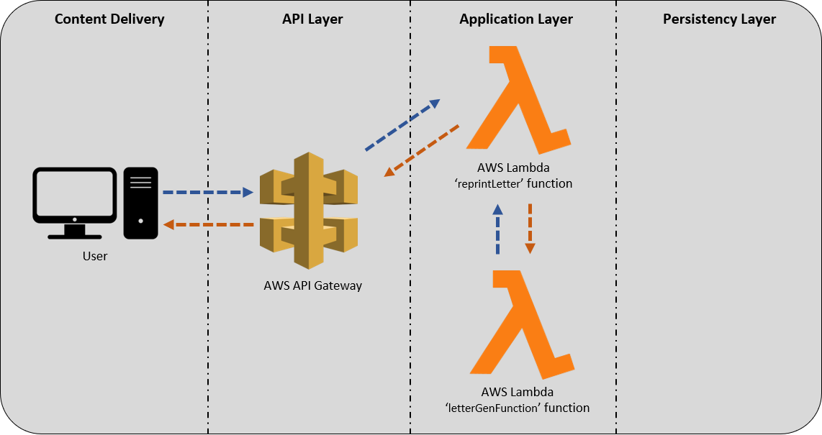
/reprint-letter
AWS API Gateway
‘reprintLetter’ Lambda
Other
Deny method
Detail how to close loan
GET
Http type?
POST
letterGen-Function
(Close letter)
Errors?
No
Yes
Return confirmation
Return error data

Slide 11
/downloadPDF
AWS API Gateway
Detail how to download letter
‘downloadPDF’ Lambda
No
GET
Http type?
Other
Deny method
Query string?
Yes
Download specified letter
printed-documents
‘downloadPDF’ function
AWS S3
‘printed-documents’
Errors?
No
Yes
Return confirmation
Return error data

Slide 12
Technology Components
AWS API Gateway
AWS Lambda
Pros:
API access controls
Integration with calling AWS Lambda functions
Quick detailed testing functionality
Cons:
Difficulty handling Http request bodies
Singe point of failure
Pros:
Only pay for compute time
No need to spin up or down instances
Serverless
Cons:
No control over environment
Data is not retained within the function
Timeboxed
AWS DynamoDB
AWS S3 Buckets
Pros:
Simple to use
Fast performance
Scalable
Enables key-value storage
Cons:
Difficult to query
Data types are limited when used with Python
No control of stored-data ordering
Pros:
Highly available and redundant
Can control the location of storage globally
Scalable
Cons:
Security controls can be difficult
Cost of usage can escalate quickly

Slide 13
Lessons Learned
Use static pages for GUI rather than string text
RDS may be better for related data for reports and statistics i.e. Loans to Customers
Realistically there would be an influx of document requests at night during bulk delete. Would an EC2 instance be better there, and AWS Lambda during the day at low volumes?
Review of technology component documentation advised
Validation of all routes for multi-access components be tested at development i.e. testing AWS Lambda returned different results to API Gateway
Better understanding of Security and privileges required. Currently difficult to understand and determine what access is required at each level
Save AWS secret keys as global variables but on AWS Educate account these reset with every launch

Slide 14
References
Billock, M. (2017) The Pros and Cons of AWS Lambda. Available at: https://dzone.com/articles/the-pros-and-cons-of-aws-lambda (Accessed: 01 July 2021)
Bonig, M. (2019) The Pros and Cons of DynamoDB. Available at: https://matthewbonig.com/2019/06/28/dynamodb-pros-cons/ (Accessed: 01 July 2021)
Pro’s and cons of using an API Gateway Available at: https://dashbird.io/knowledge-base/api-gateway/pros-and-cons-of-using-an-api-gateway/ (Accessed: 01 July 2021)

